Slide 1
活动签到小程序
全栈开发课程
— 肖林刚

Slide 2
课程形式
课程采用录播形式
课程源码下载：https://github.com/agangdi/wx-miniprogram-mini-course
答疑：https://github.com/agangdi/wx-miniprogram-mini-course/issues
解惑：关键词、权威文档、现场（或视频）答疑
讨论：同答疑

Slide 3
课程内容（即完整架构）
服务端：linux+nginx+php+mysql
客户端：uni-app(vue.js+css+html+Hbuilder)
框架：laravel
通信协议：http
其他工具：vscode 小程序开发工具 composer

Slide 4
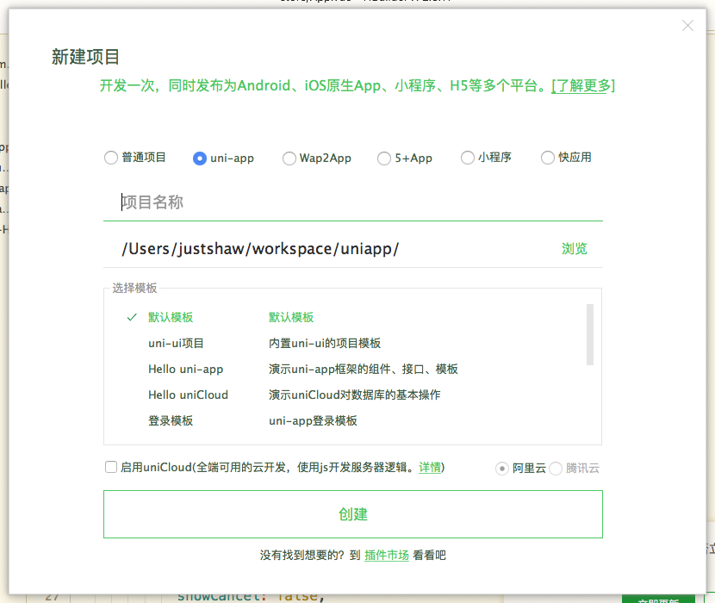
创建uni-app项目
Hbuilder：文件——新建——项目

Slide 5
Hello World
“Hello World” from web server

Slide 6
Create laravel project
Install composer: php -r "readfile('https://getcomposer.org/installer');" | php
mkdir signIn && cd signIn
composer create-project —prefer-dist laravel/laravel
Tips: https://docs.phpcomposer.com/00-intro.html
https://laravel.com/docs/7.x

Slide 7
Nginx 安装
MacOS: brew install nginx
CentOs: yum install nginx
Ubuntu: apt-get install nginx
Windows: http://nginx.org/en/docs/windows.html

Slide 8
Nginx 配置
server {
listen 8899;
server_name 127.0.0.1;
access_log /var/log/nginx/sign.access.log main;
error_log /var/log/nginx/sign.error.log;
set $this_root {dirname}/public;
root $this_root;
index index.php index.htm;
error_page 404 /404.html;
error_page 500 502 503 504 /50x.html;
location = /50x.html {
index error.html;
}
location / {
try_files $uri /index.php?$args;
}
location ~ \.php$ {
fastcgi_param SCRIPT_FILENAME $this_root$fastcgi_script_name;
fastcgi_pass 127.0.0.1:9000;
fastcgi_index index.php;
include fastcgi_params;
}
}

Slide 9
php 的安装：https://www.php.net/downloads.php
php-fpm 配置:
/etc/php-fpm.d/
/usr/local/etc/php-fpm.d/
/usr/local/php-fpm/
php-fpm 启动：php-fpm
php-fpm -c [config file path]

Slide 10
Hello World from larval

Slide 11

Uni-app
微信小程序
Nginx
Php-fpm
Php
http
Fastcgi
Invoke
127.0.0.1:9000

Slide 12
作业：
按照课程内容，跑通直到 hello world from larval
搞清楚一个http请求中，涉及到的字段有哪些，及其所表示意思。

